Slide 1

Stock Portfolio Diversification using Time Series Analysis and Machine Learning
Kedar Ghule
Department of Electrical and Computer Engineering
College of Engineering
Northeastern University

Slide 2
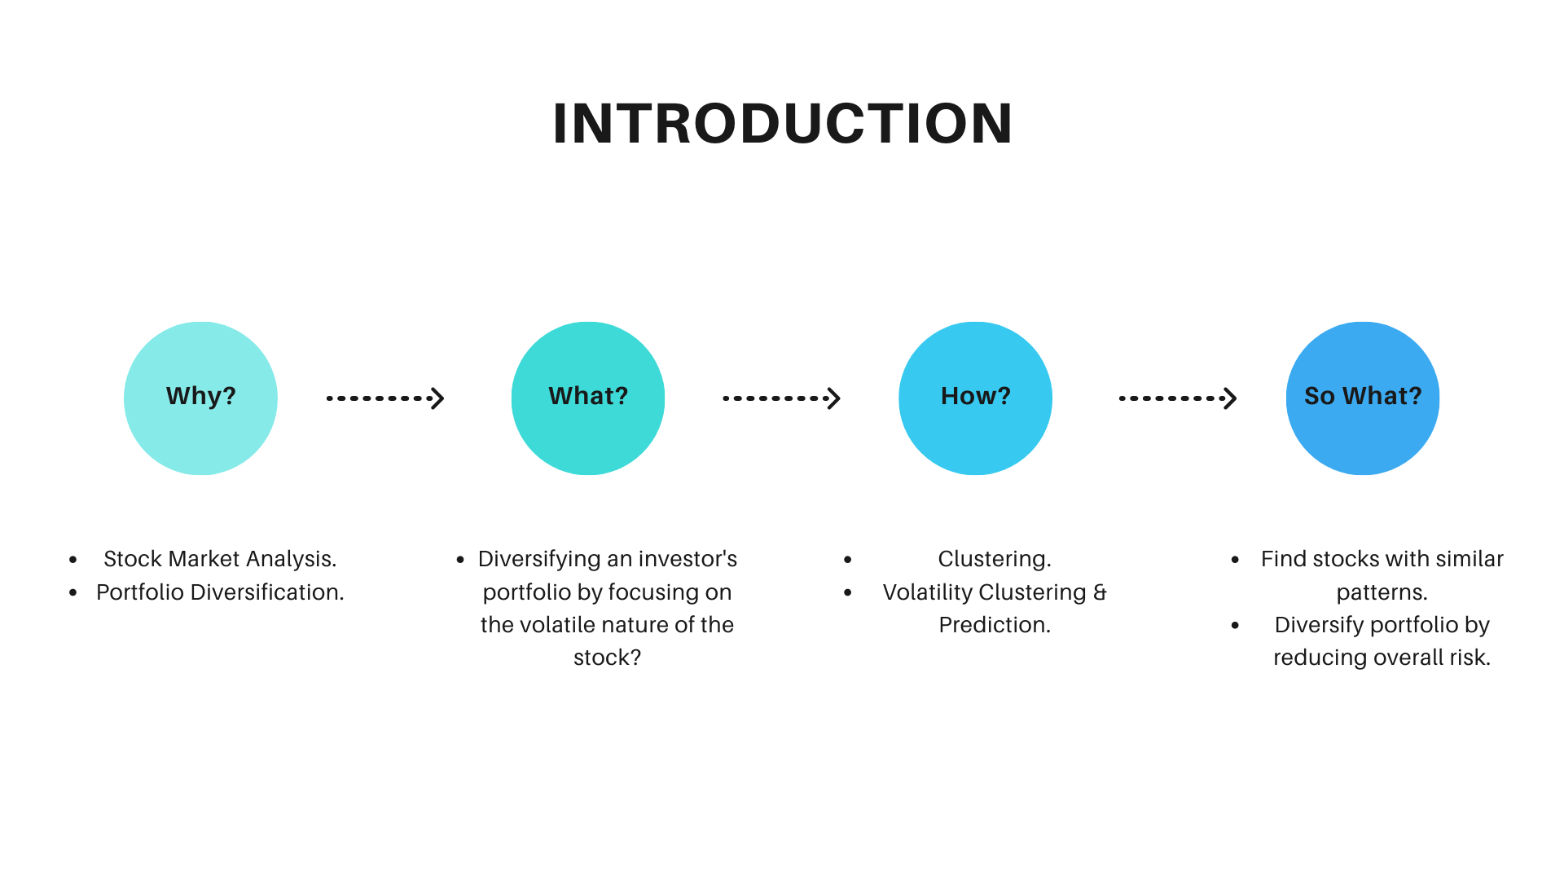

Slide 3
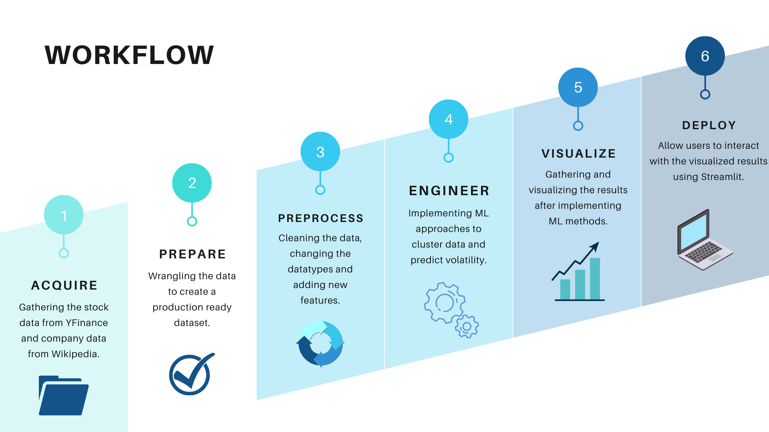

Slide 4
K-Means Clustering
Performed on percentage of weekly returns of each stock.
Used Elbow method to determine optimal number of clusters.
Implemented Silhouette analysis to determine degree of separation between the clusters.

Slide 5
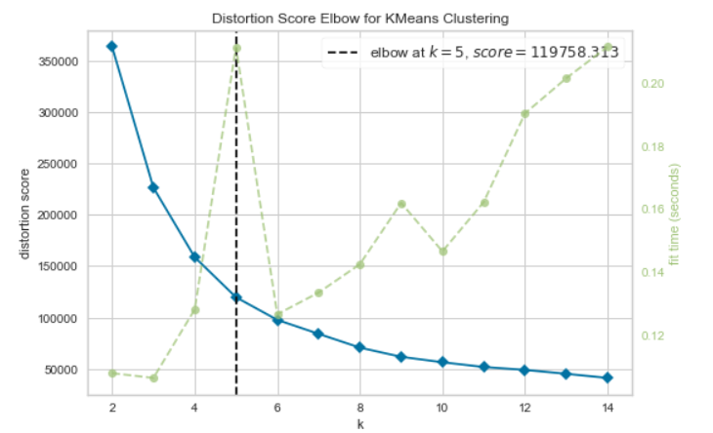
K-Means: Results and Observations
Elbow Method
Silhouette Analysis
Silhouette score of 0.4568

Slide 6
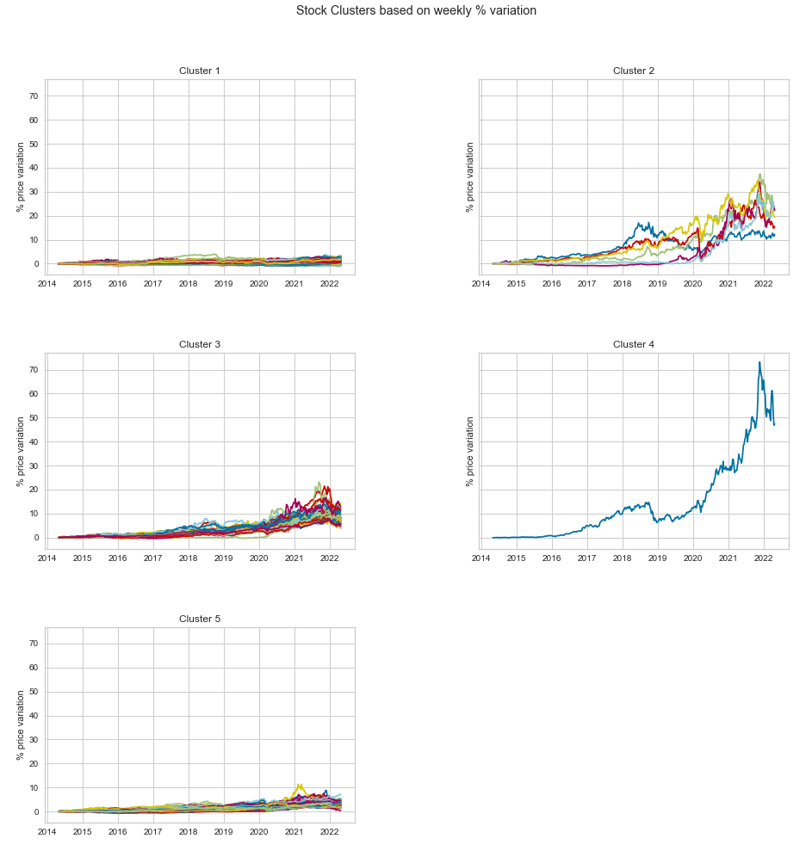
K-Means: Results
Cluster 1 – 305 stocks (e.g. Bank of America, AT&T).
Cluster 2 – 6 stocks (e.g. AMD, Tesla).
Cluster 3 – 40 stocks (e.g. Apple, Moderna).
Cluster 4 – 1 stock (NVIDIA).
Cluster 5 – 152 stocks (e.g. Google, Texas Instruments).

Slide 7
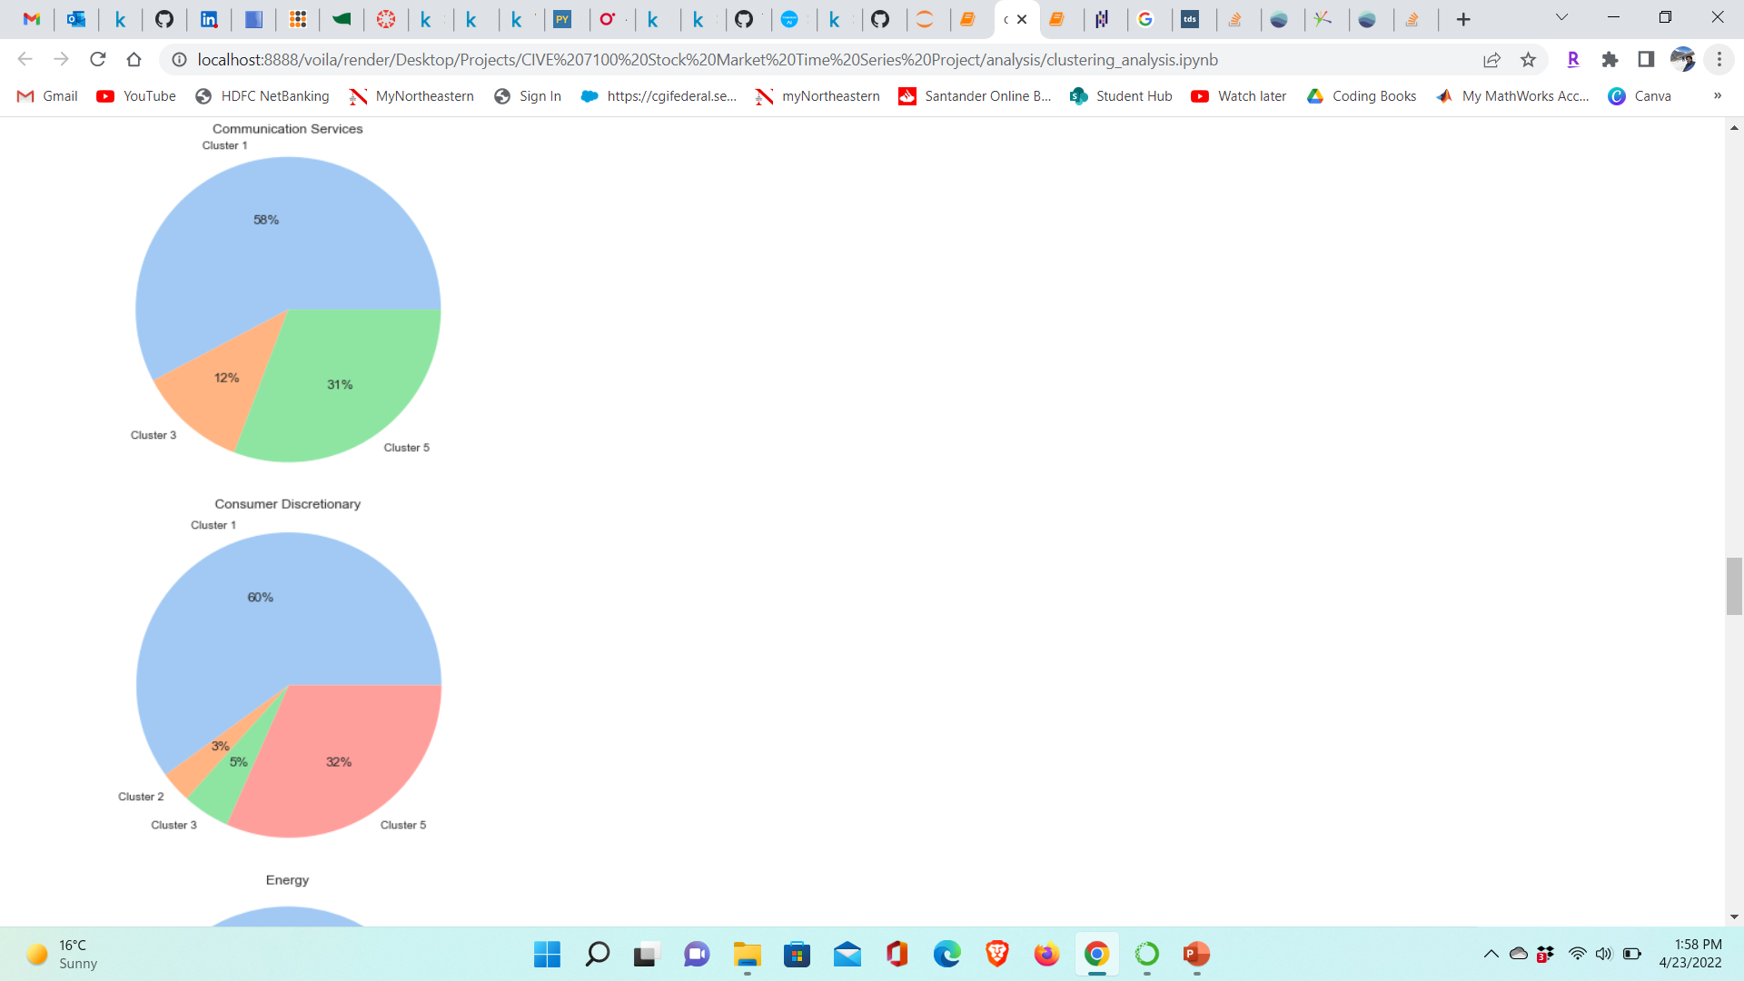
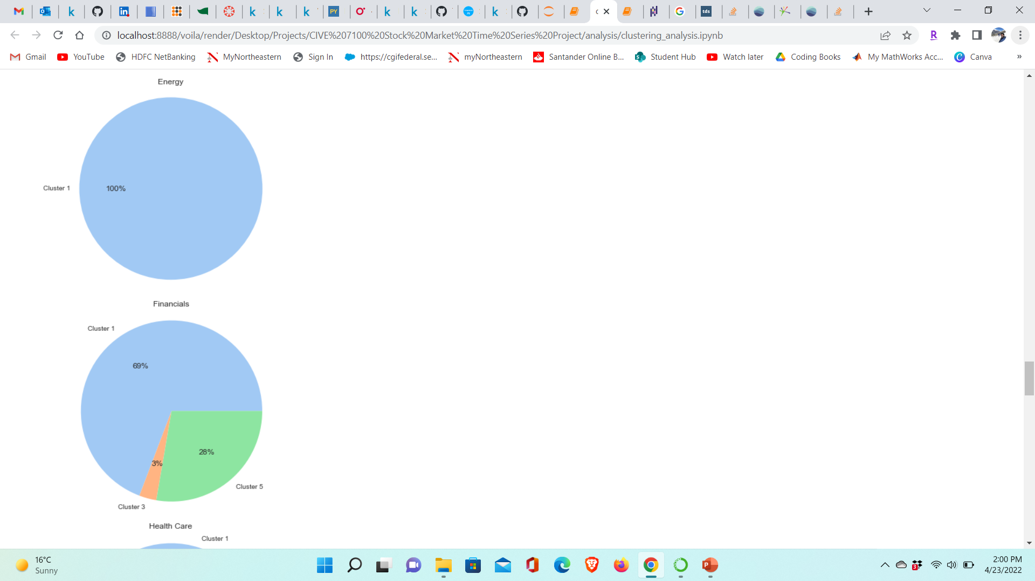
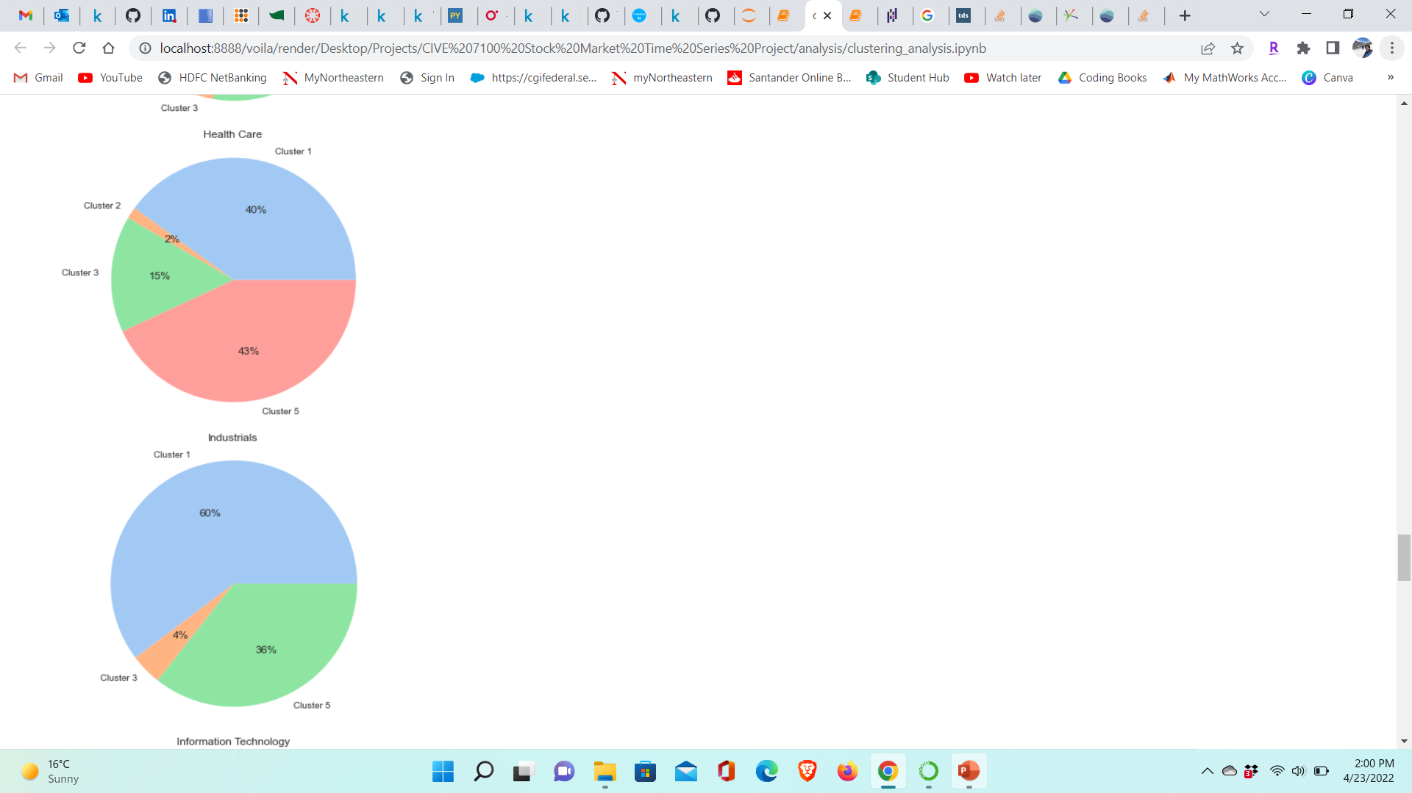
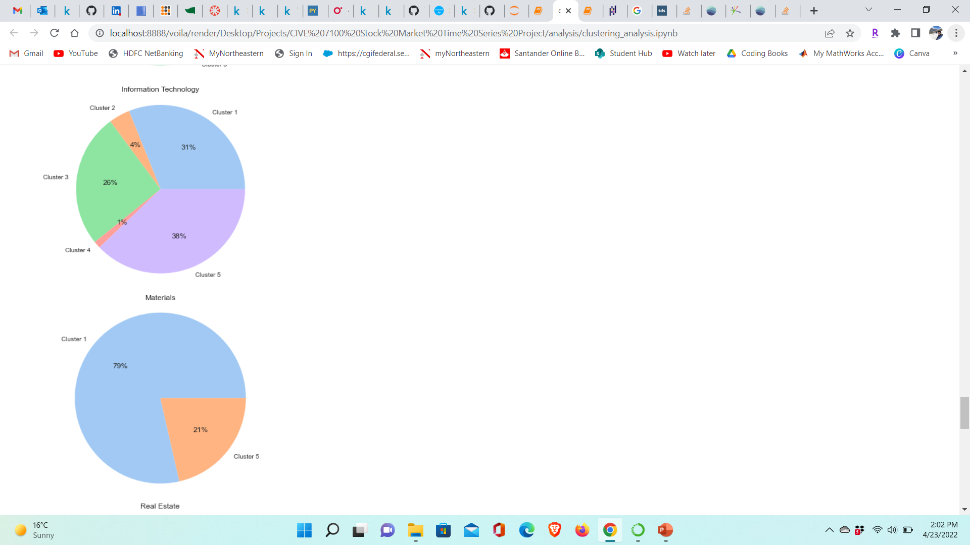
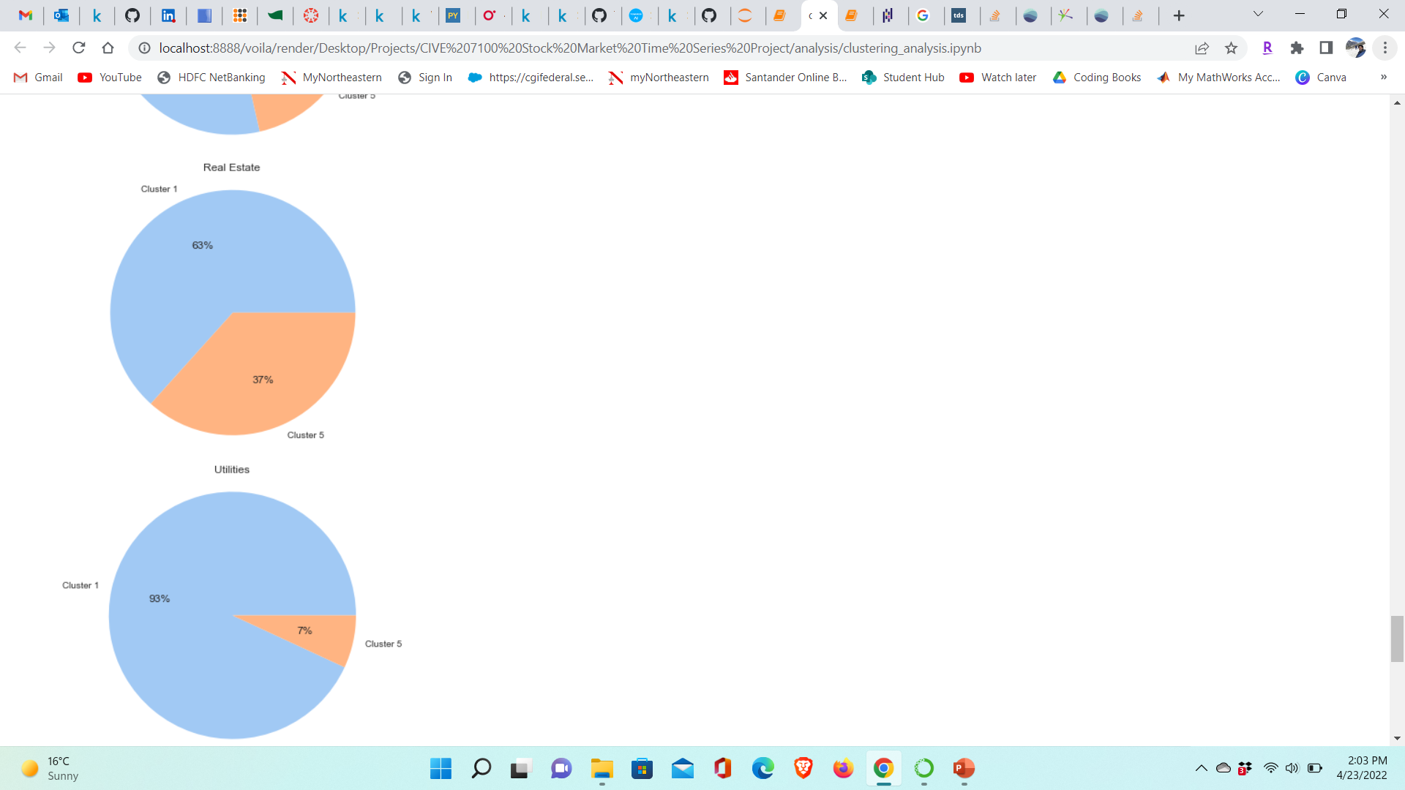
K-Means: Results

Slide 8
Volatility Clustering and Prediction
Calculate realized volatility (weekly) and daily, monthly and annual volatility percentage.
Implement classical volatility models and ML based approaches.
Visualize the results and evaluate the models.
S&P 500 data used for prototyping

Slide 9
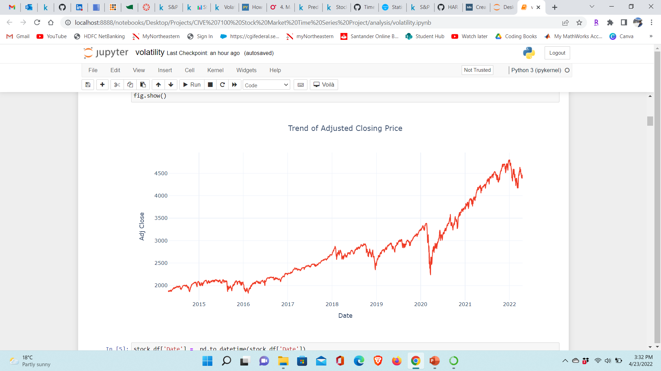
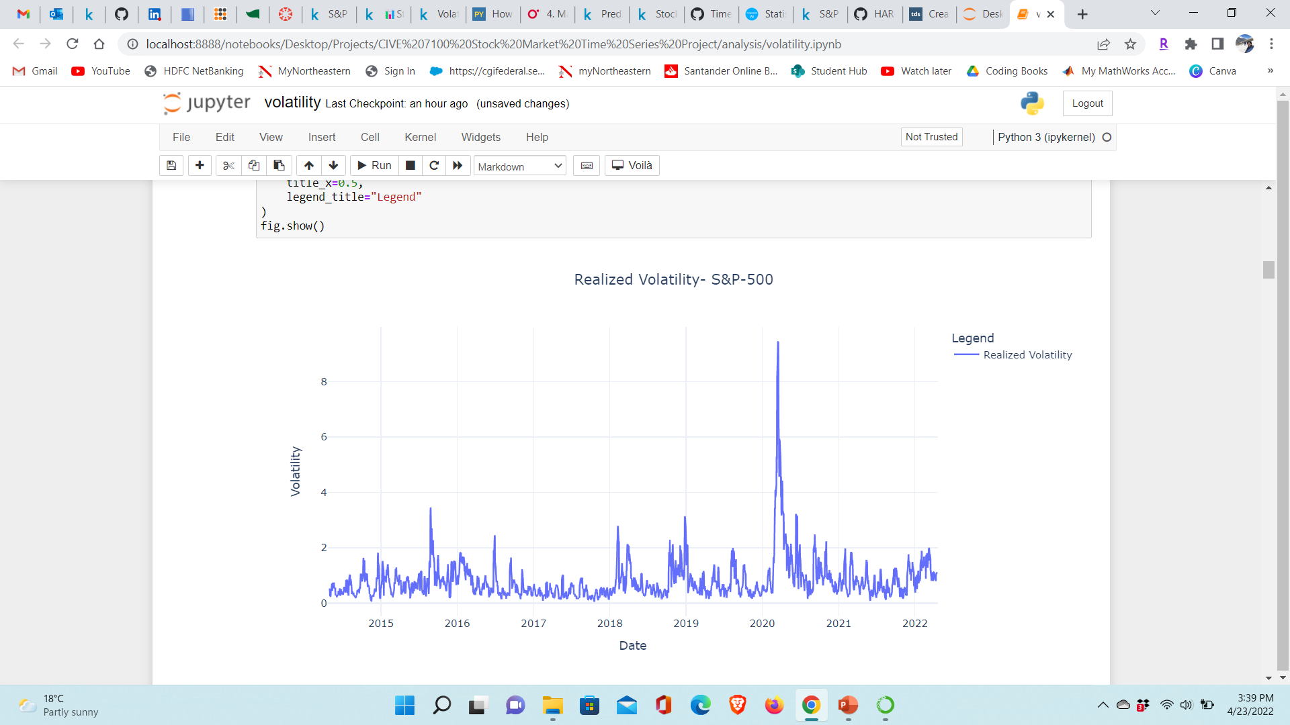
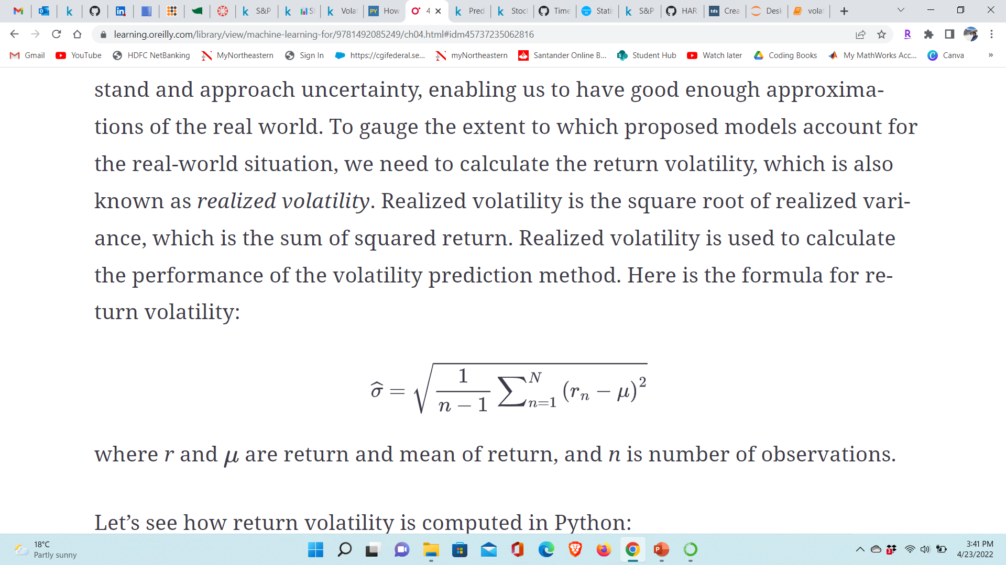
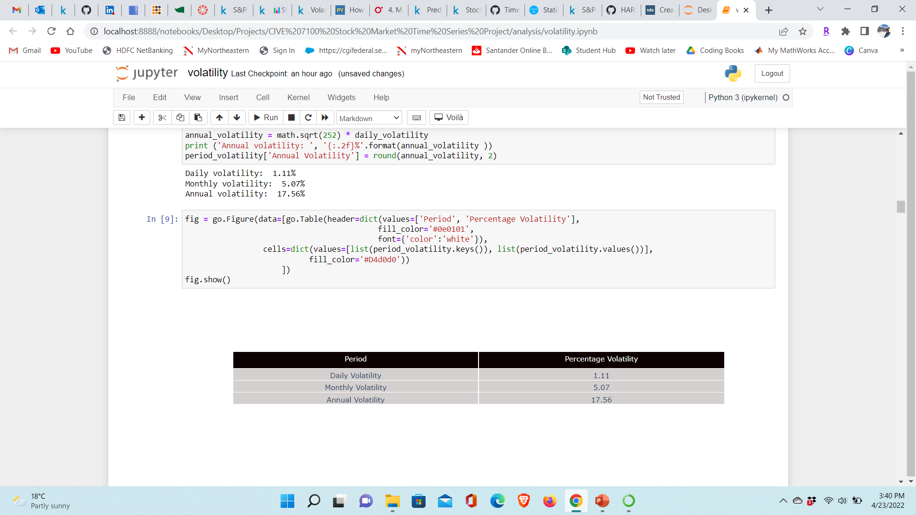
Volatility Clustering & Prediction
The formula for realized volatility is -

Slide 10
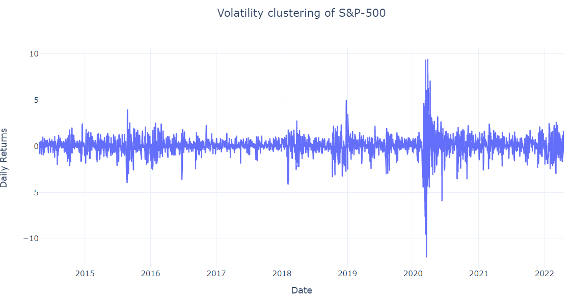
Volatility Clustering & Prediction

Slide 11
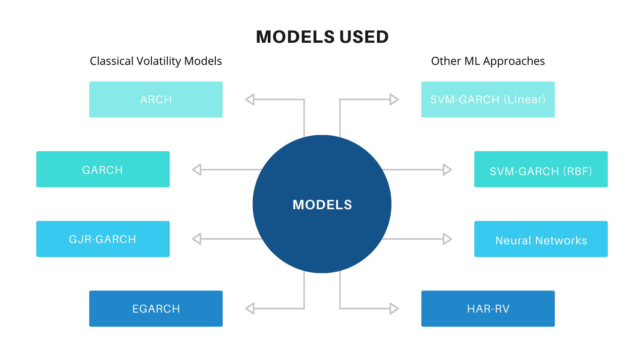

Slide 12
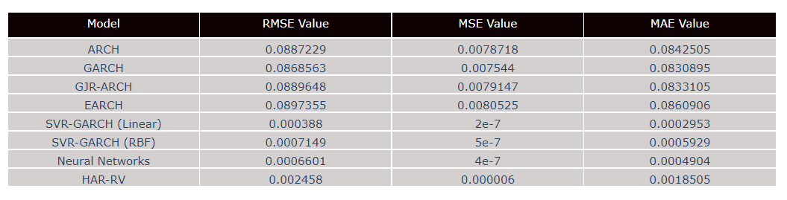
Results of Volatility Prediction
ML methods outperform classical volatility models.
NNs > SVR-GARCH > HAR-RV > GARCH.
Not major performance difference between the classical volatility models.

Slide 13
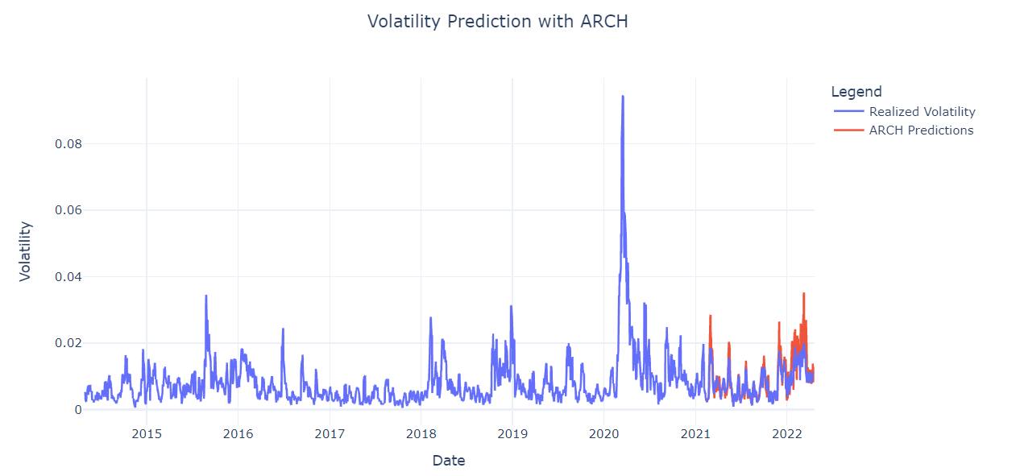
ARCH Model

Slide 14
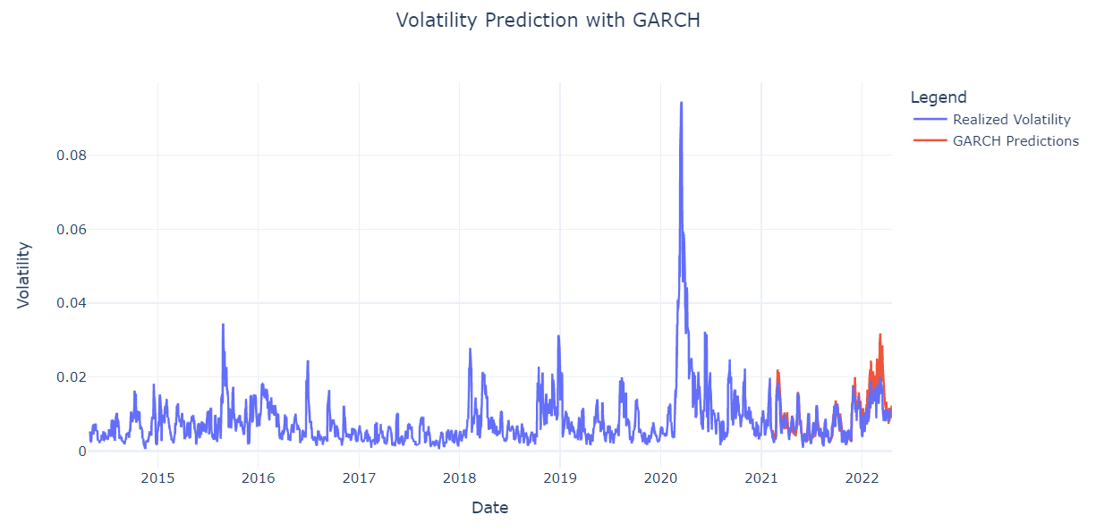
GARCH Model

Slide 15
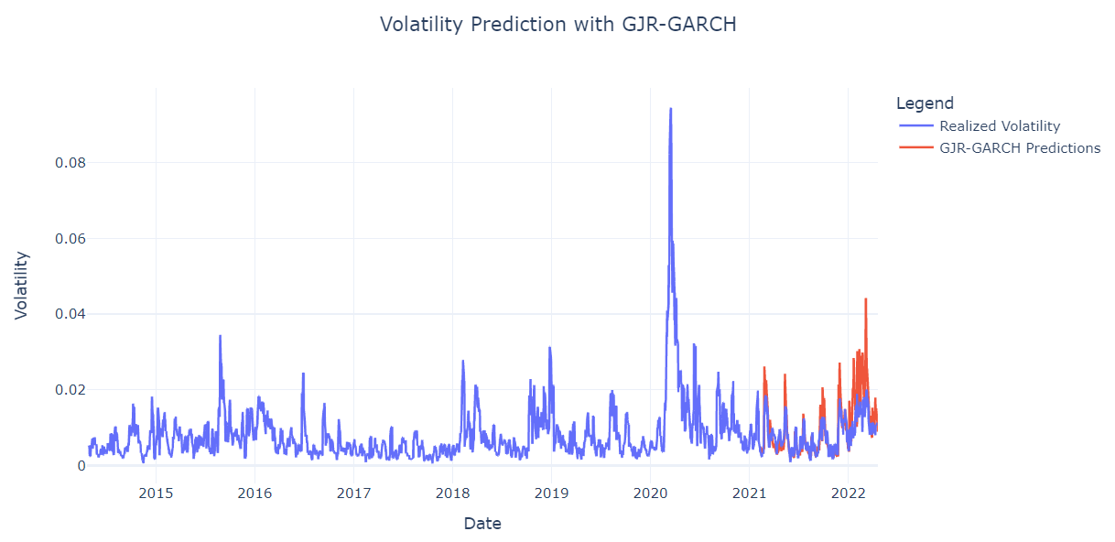
GJR-GARCH Model

Slide 16
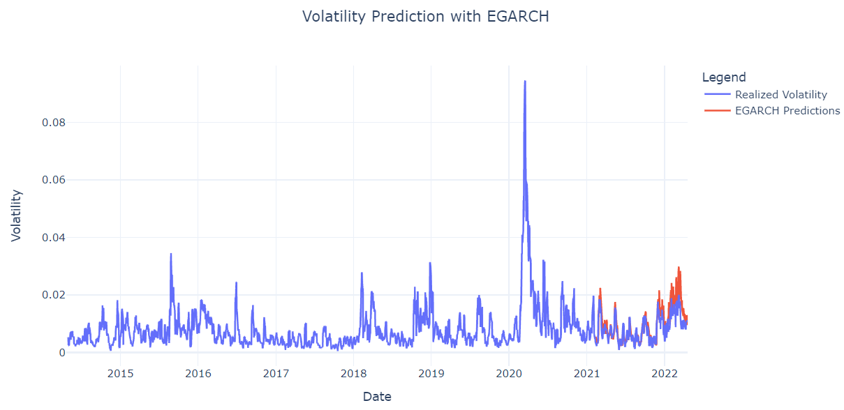
EGARCH Model

Slide 17
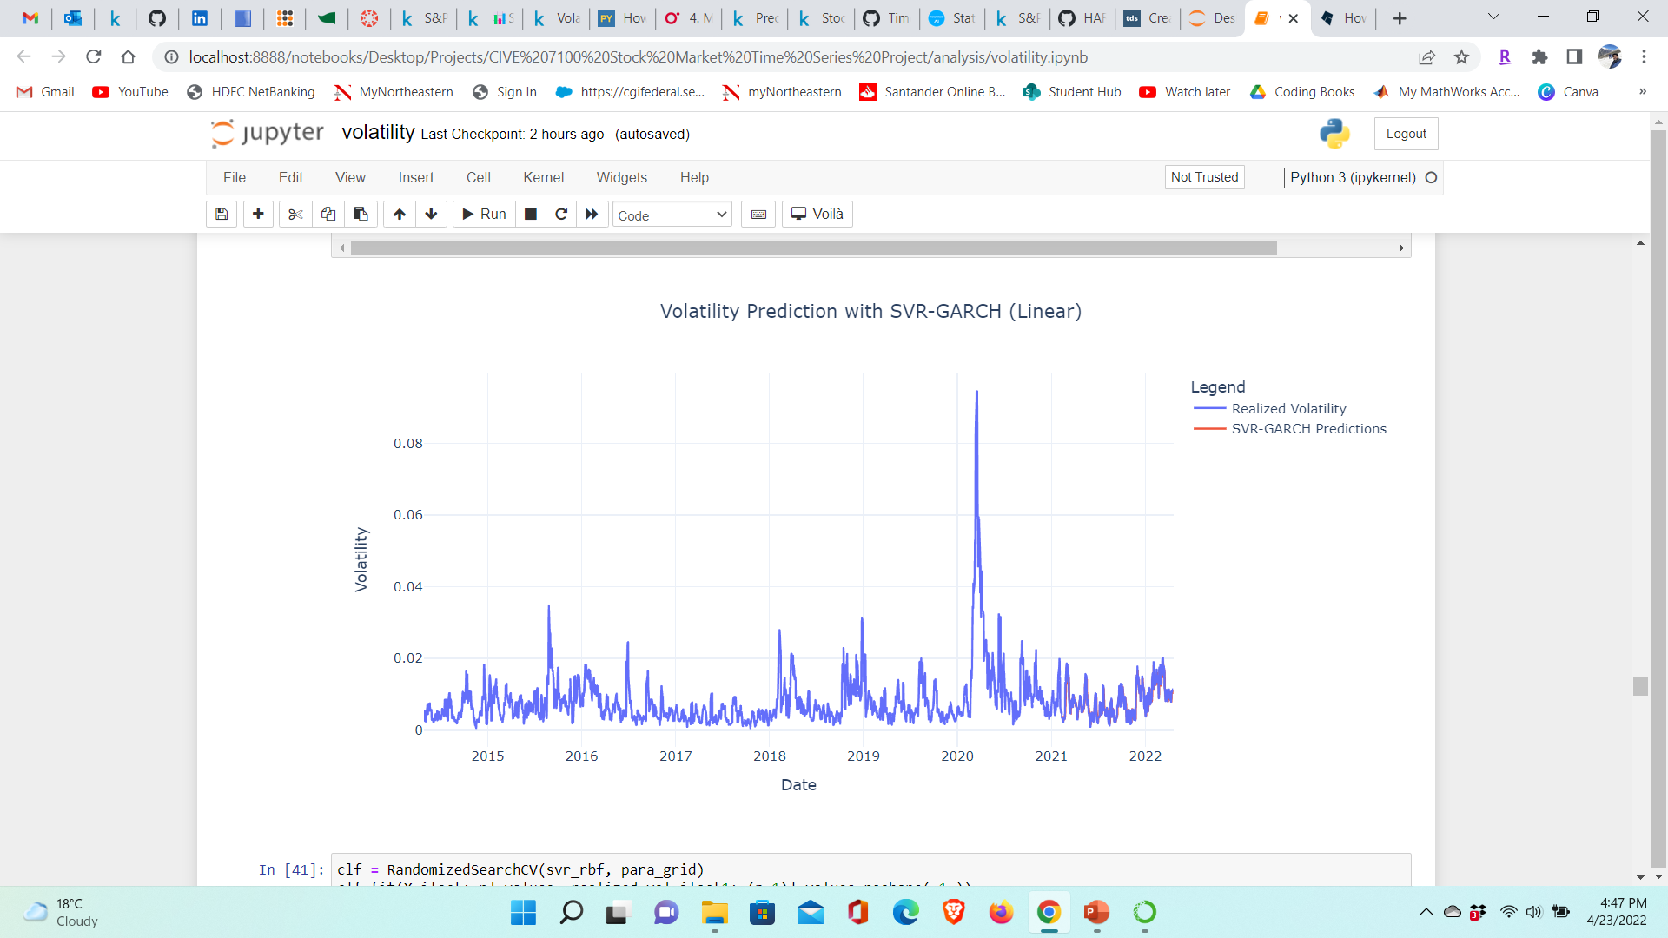
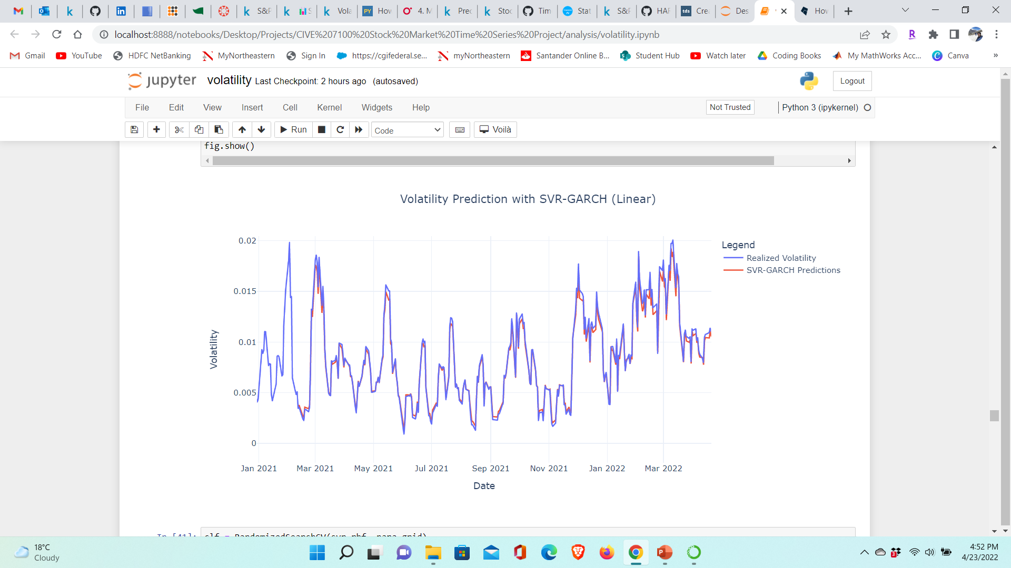
SVR-GARCH Model (linear kernel)
In the parameter selection part of the SVR model, a validation procedure based on randomized search is used to select the two free parameters ϵ and C and one kernel coefficient γ.

Slide 18
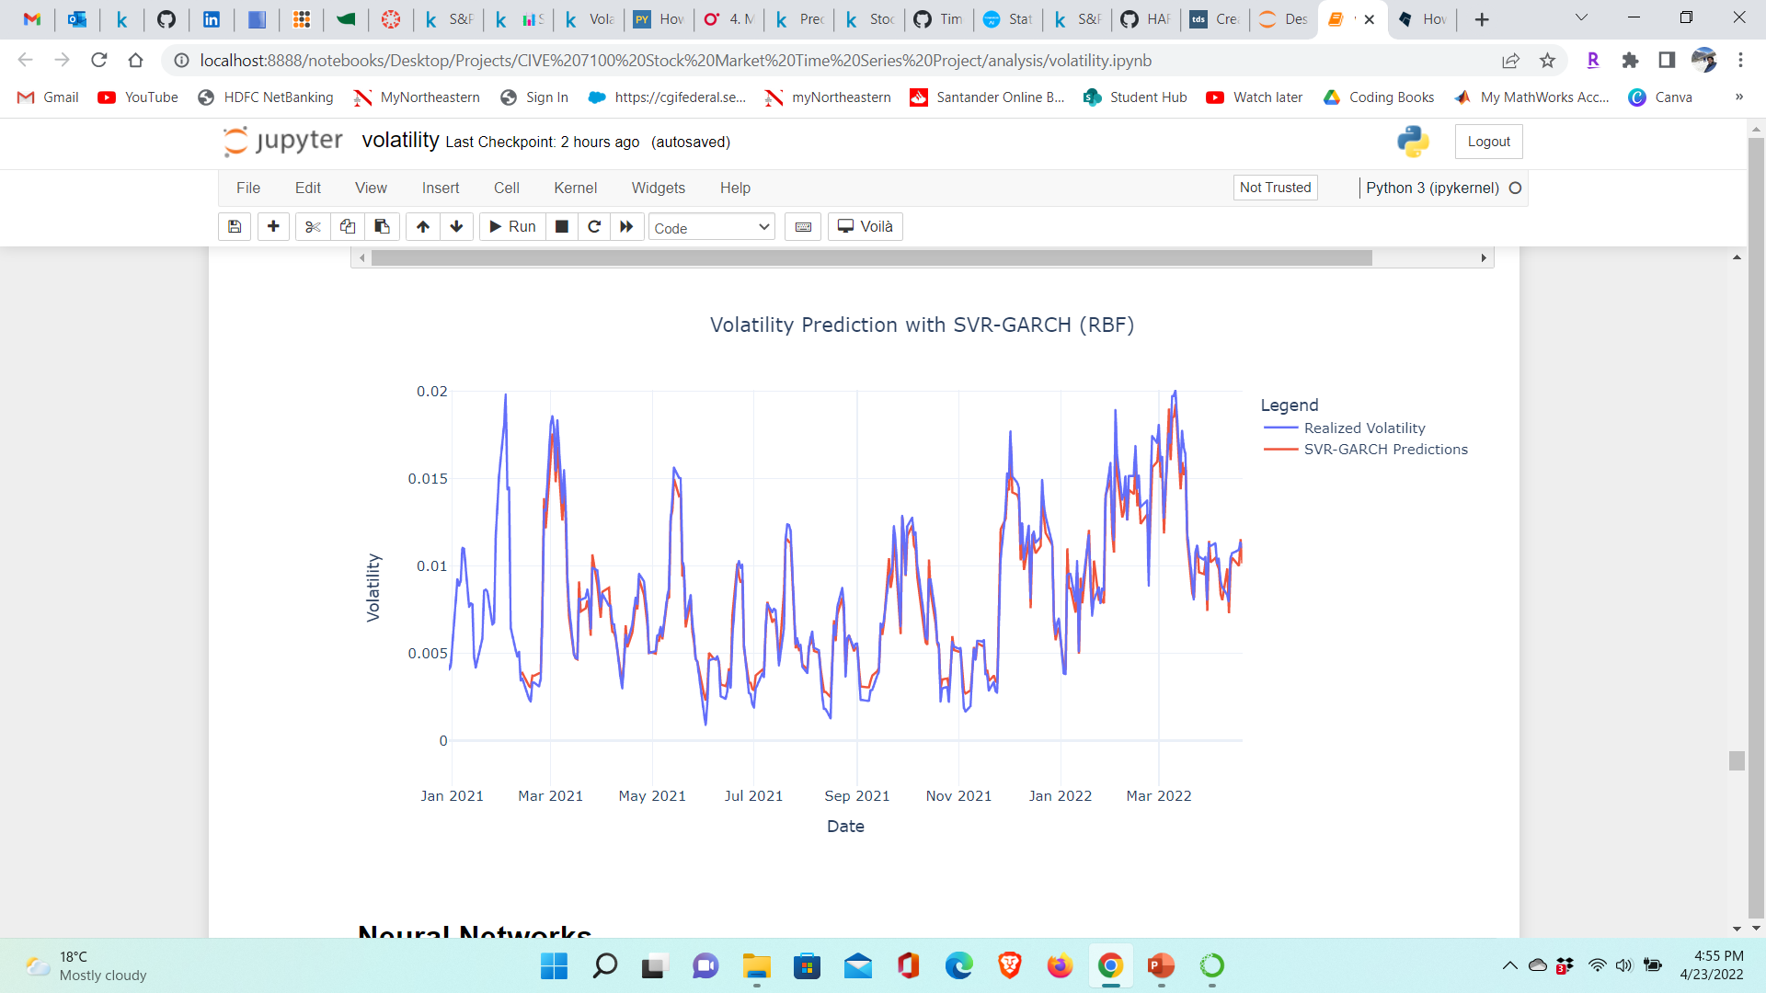
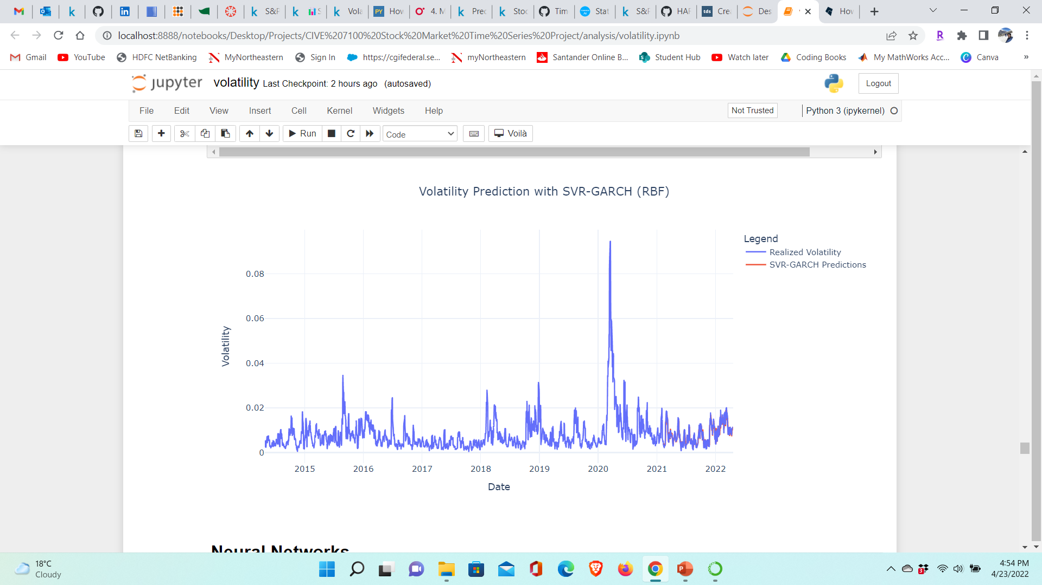
SVR-GARCH Model (RBF kernel)

Slide 19
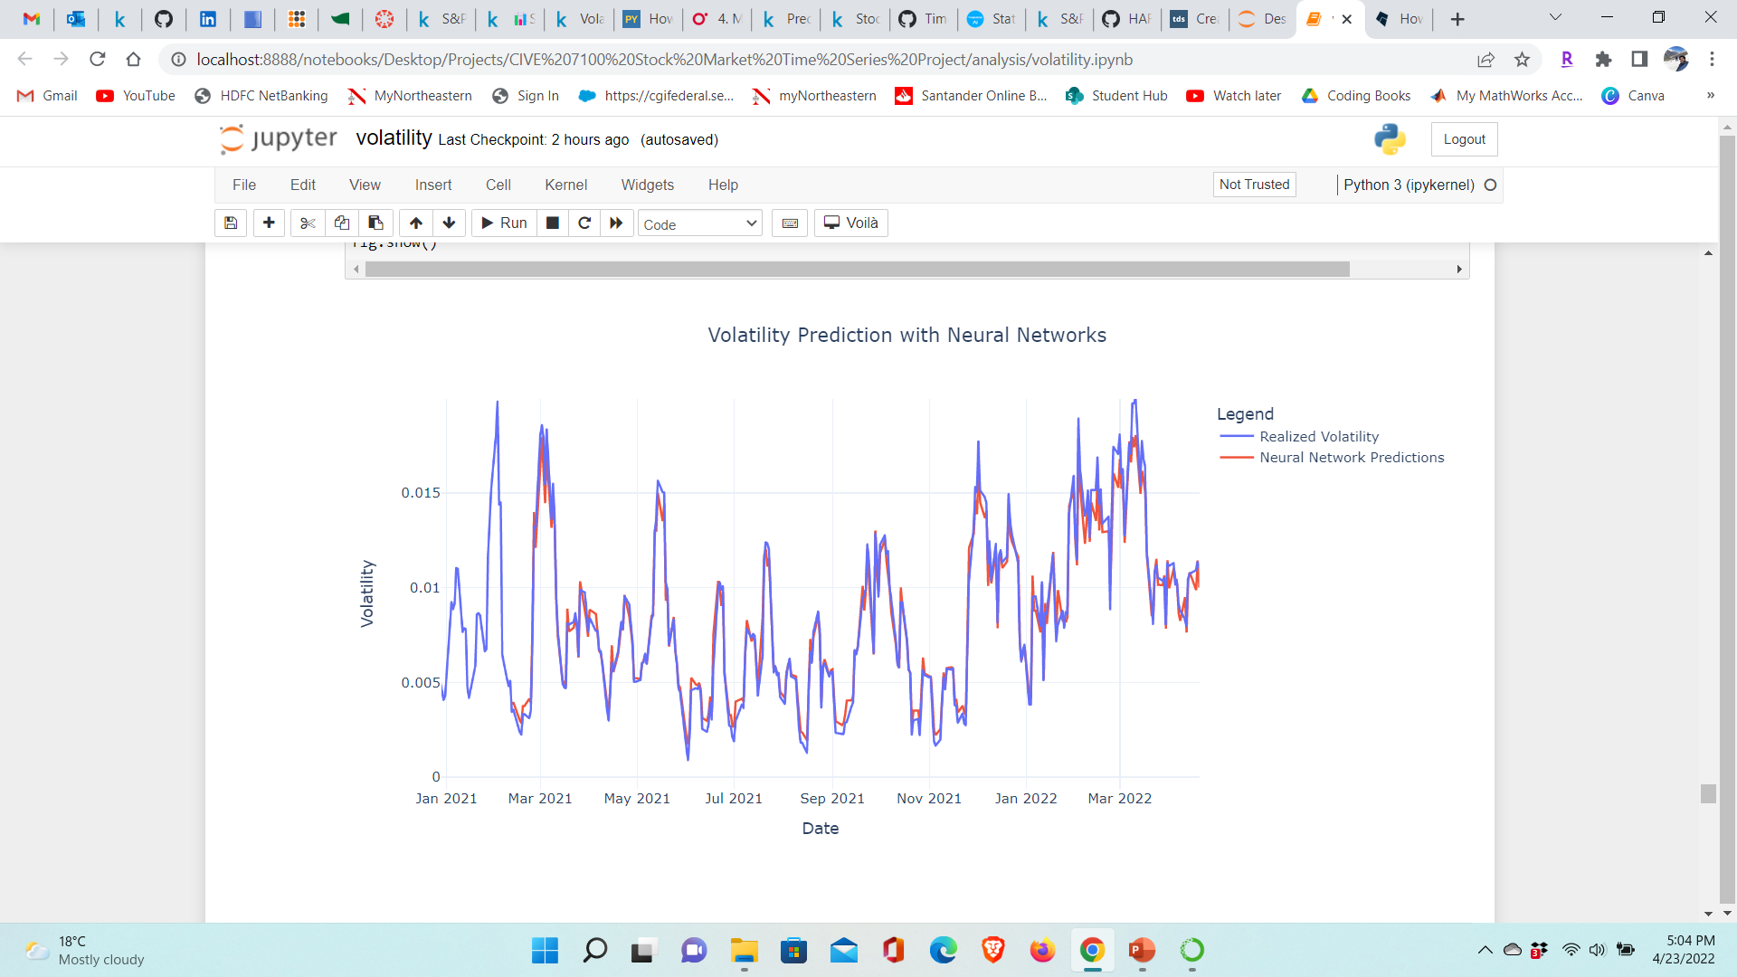
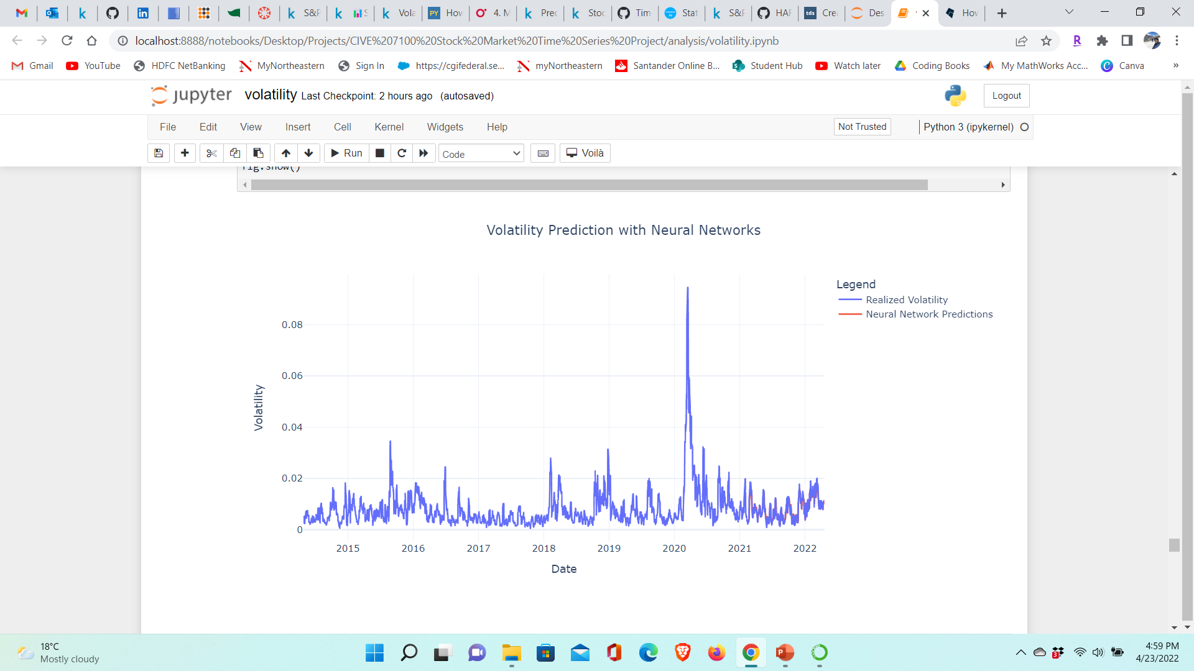
Neural Networks
Two hidden layers – one with 256 neurons and second with 128 neurons and one output neuron since volatility is of continuous type. ReLU activation function used in hidden layers.

Slide 20
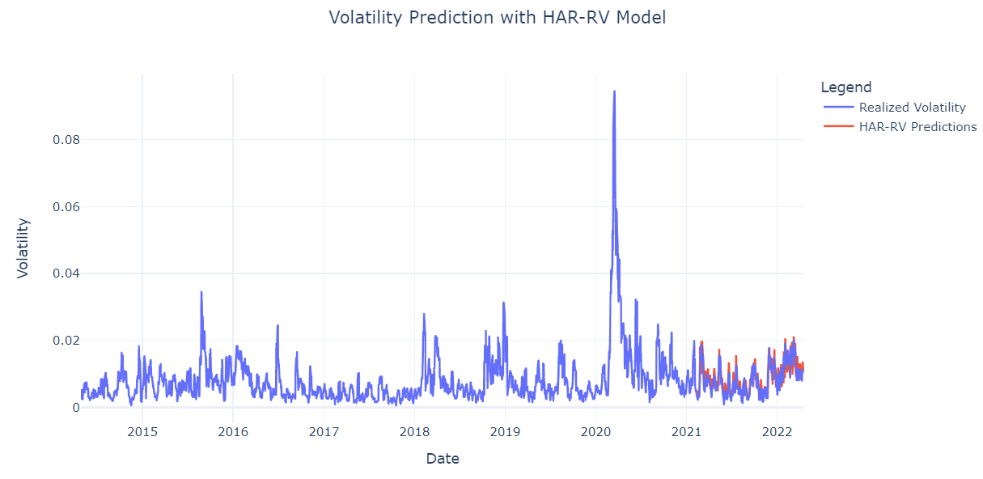
HAR-RV Model
Forecasting realized volatility in one day by considering the realized volatility of the previous week and previous month.

Slide 21

Demo

Slide 22
Inference
Stocks that are volatile for a long time will remain volatile while stocks that are non-volatile for a long time, will remain non-volatile.
Uncertainty makes volatility an important aspect while diversifying your portfolio.

Slide 23
Future Work
Predicting volatility by considering an implied volatility index like VIX or daily traded volume.
Predicting volatility of traditionally neglected categories like municipal bonds.
Implementing volatility prediction and clustering on sector indexes to see which overall industry is more volatile than the others.

Slide 24
References
Haugom, Erik and Haugom, Erik and Langeland, Henrik and Molnár, Peter and Westgaard, Sjur, Forecasting Volatility of the U.S. Oil Market (January 29, 2014). Available at SSRN: https://ssrn.com/abstract=2691391 or http://dx.doi.org/10.2139/ssrn.2691391
Sun, H., Yu, B. Forecasting Financial Returns Volatility: A GARCH-SVR Model. Comput Econ 55, 451–471 (2020). https://doi.org/10.1007/s10614-019-09896-w
Machine Learning for Financial Risk Management with Python by Abdullah Karasan.

Slide 25

Thank you!

